Slide 1
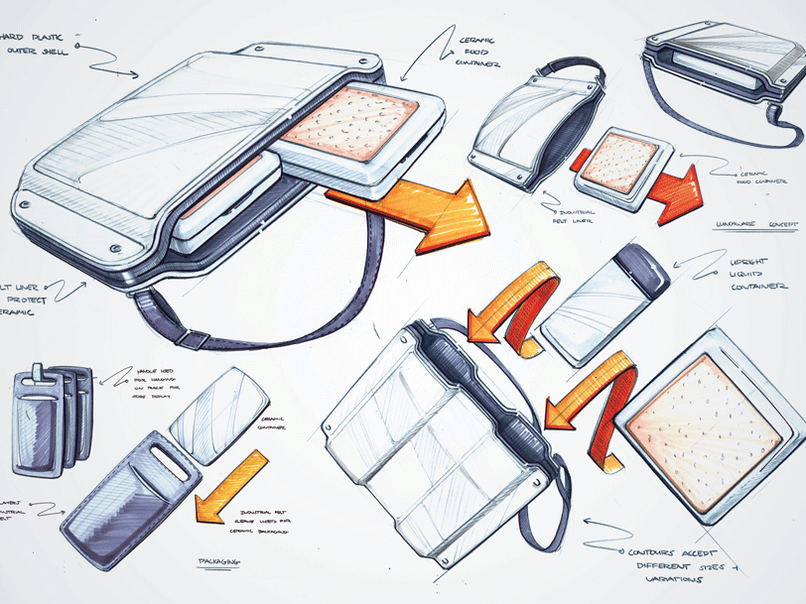
Higher Design & Manufacture
Graphics in the Design Process

Slide 2
Learning intentions & success criteria
Learning Intentions
Gaining a knowledge of the different graphics used throughout the design process.
Success Criteria
I can apply my drawing skills to produce different types of graphics throughout my design folio.
I understand the value of using different graphics to demonstrate different information about my product design.

Slide 3
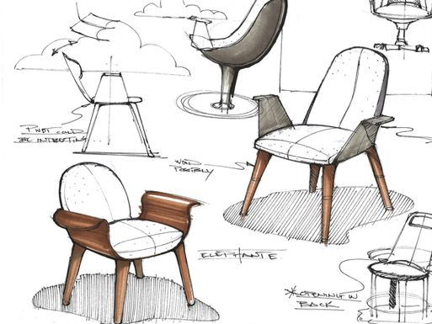
The use of graphics in the design process
In the design process, it is important to consider which type of graphics are required to help:
Visualise, define and communicate the development of a design proposal.
Generate and explore ideas
Test and refine ideas in relation to aesthetics and ergonomics.
At different stages in the design process, it is necessary to consider which type of graphic technique should be used for a specific purpose.
When the graphics are chosen and employed correctly, they can enhance the design process, however it can take time to develop your skills and create the appropriate graphics.

Slide 4
Notes for developing your graphic skills
Basic sketching skills must be established before moving on to more complex drawing types.
Follow the guidance and strategies and develop confidence in applying graphics quickly and freely throughout the design process.
Do not be too precious about your graphics as time is limited.
Develop the skills and techniques to allow for mistakes, experimentation and exploration.

Slide 5
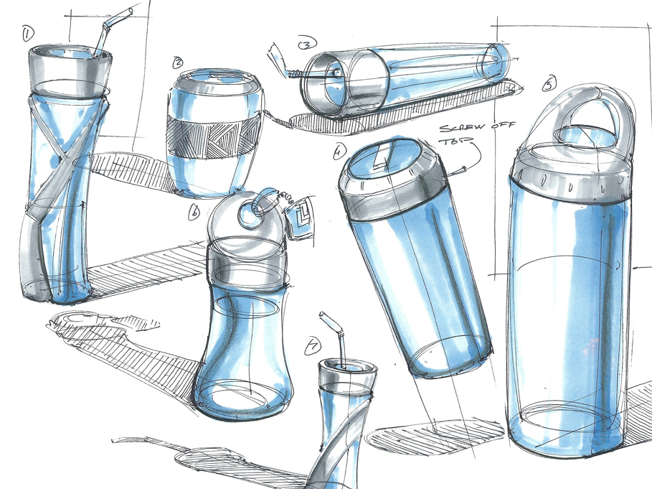
Notes for developing your graphic skills
The following pages will help you decide which type of graphics to use and when to use them throughout the design process. This will cover:
Sketches
Orthographic (2D) drawings
Pictorial (3D) drawings
Sectional drawings
Perspective drawings
Exploded View drawings
3D models (physical and CAD)
Task 1
Have a look at an existing folio to see the range of different graphics being used at different stages. Try to explain why each type of graphic has been used and how it is useful.

Slide 6
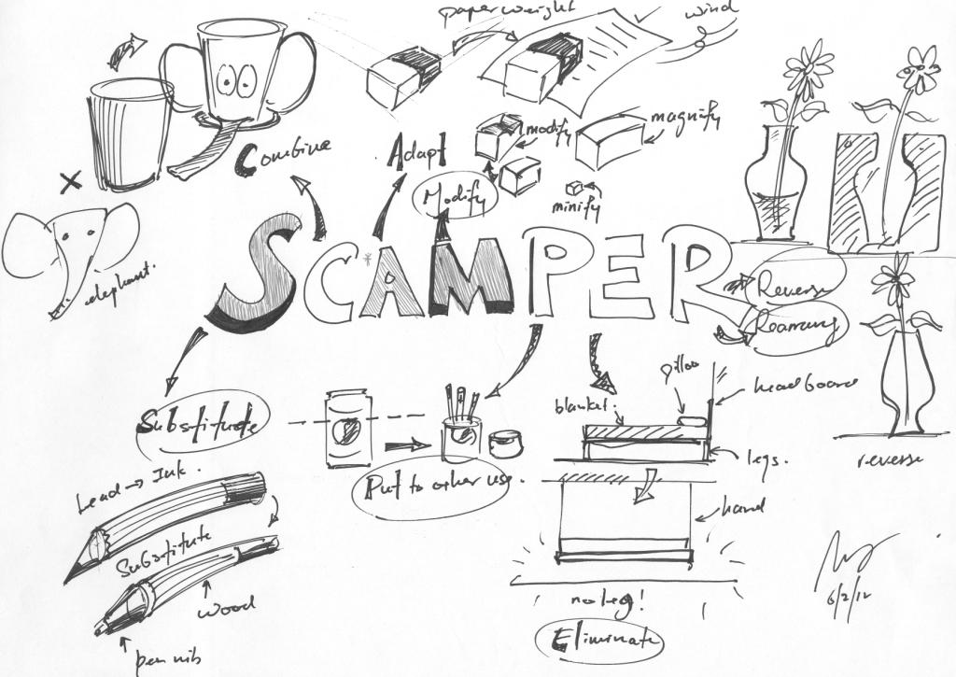
sketches
At the very beginning of the design process, you may have an idea in your head of what the product may look like. Using idea-generation techniques (see separate booklet), you may come up with some initial sketch ideas.
For example, the drawing below shows ideas generated using SCAMPER (substitute, combine, modify, put to another use, eliminate, rearrange).

Slide 7
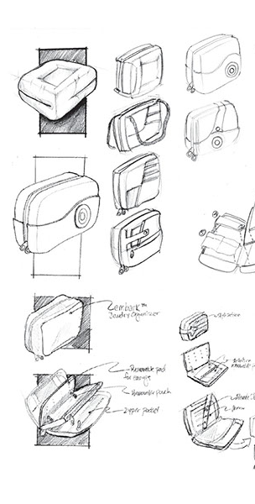
sketches
At this stage in the design process, simple sketches can be used to show initial thoughts and ideas for a product.
They tend to include lots of annotation to help explain the thought process behind the idea. At this stage, you may have multiple pages of small sketches to allow all of your initial ideas to manifest on paper. Next, you could use some of these idea-generation techniques to produce a number of initial ideas in more detail.
Task 2
Use one idea-generation technique to come up with a series of small sketches on an A3 page. Try drawing these both in 2D and 3D and include annotation. These should be quick, timed sketches. Do not be too precious about them!

Slide 8
Orthographics (2D)
Orthographic drawings represent a 3D object in 2D. Before a product is manufactured, accurate detailed drawings must be produced. These drawings are made using orthographic projection and is usually drawn in up to four 2D views:
Elevation (front view)
Plan (top view)
End Elevation (one or two side views)
Orthographic drawings should contain dimensions to give detailed information the size of the product both to the manufacturer. Overall sizes may be more appropriate but very useful for the consumer.
Orthographic drawings can either be produced by hand on a drawing board with drawing equipment, or they can be produced using 3D CAD. A 3D model is required from which the views can be projected onto a 2D drawing.

Slide 9
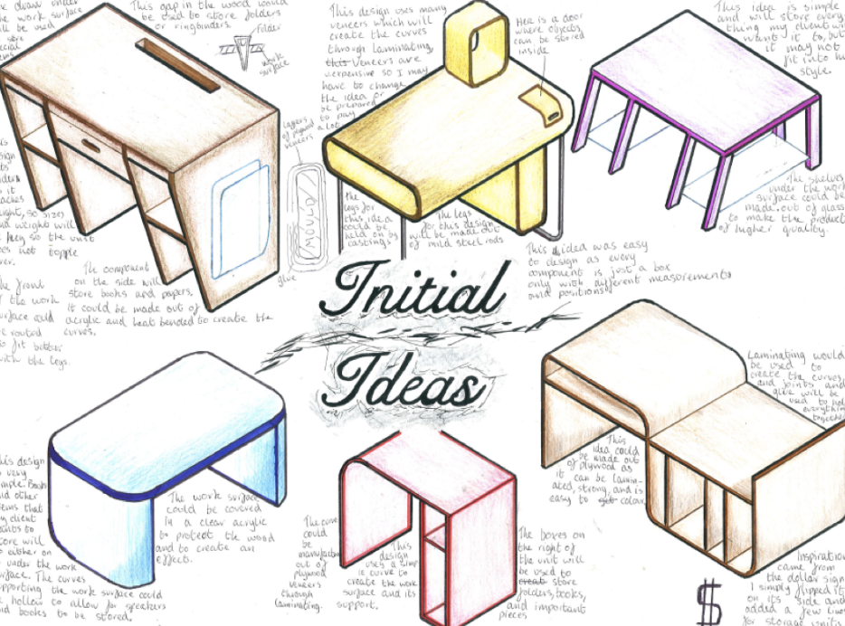
pictorial (3D)
At the initial idea stage of the design process, it is a good idea to explore these ideas both in 3D and 2D.
After using a number of idea-generation techniques (see separate booklet), you may already have some ideas explored. These can be represented using Pictorial drawings, i.e. 3D.
Below are some examples of isometric drawings for different initial ideas for a desk design.

Slide 10
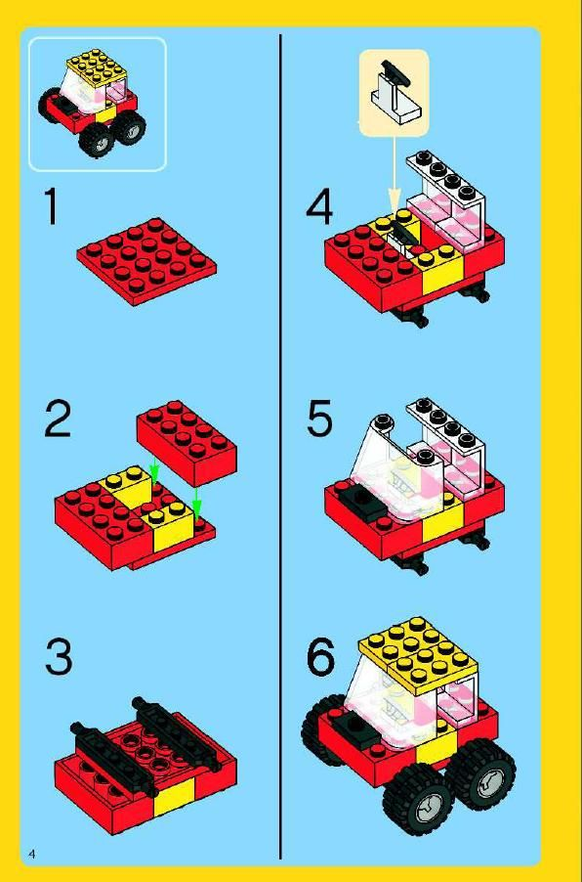
pictorial (3D)
Isometrics are the most commonly used method of pictorial drawing, with all heights drawn vertically and all angles drawn at 30° to the horizontal. The true dimension of the object should be used. It allows for all three dimensions and three surfaces to be shown in one view.
Pictorial drawings are very useful in documents such as manuals and instruction booklets, such as IKEA or Lego manuals (below).
Task 3
Select a product and attempt to create an Isometric drawing on it to practise your 3D sketching abilities.

Slide 11
Sectional drawings
Sectional views are used on drawings to show internal details of a product. They show internal construction details, which may not be obvious or seen from a normal drawing or sketch.
This type of drawing is useful both to manufacturers and consumers, particularly if there are small intricate parts or moving parts that are hidden inside the product. They can be represented in both 2D and 3D.
Examples of sectional drawings can be found in workshop and instruction manuals which show technical illustrations. It is also common to show sectional views on promotional posters to allow consumers to see key details.

Slide 12
Sectional drawings
Cutting-Planes
A chain line with thick ends shows where the object is ‘sliced’ through. Arrows indicate the direction of the view.
Cross-Hatching
Sectional views are cross-hatched at 45°, with lines approximately 5mm apart. Cross hatching occurs on the solid parts that have been ‘sliced.’ Parts of objects such as webs/ribs (except when across its length). Bolts, nuts, washers, screws or shafts should also NOT be cross-hatched.
Task 4
Take a simple object which has interior detail that you can’t see from the outside, then make an attempt to sketch the sectional view. Remember to include cross hatching where the object’s surface has been sliced.

Slide 13
perspective drawings
Perspective views are an important skill for designers. They make products appear to be more realistic and are essential when communicating with clients and consumers.
Drawings are typically either drawn as one-point perspectives or two-point perspectives.
It is important to consider the following when setting up a perspective drawing:
Consider where the horizon line will go. Depending on the effect you want to create, it can be placed high or low on the page.
Vanishing point (one-point) or points (two-point) lie on the horizon line, typically to the side of the page.
Foreshortening: as objects appear further back from the front, their dimensions should decrease to give the effect of it ‘vanishing’ into the vanishing points. This gives a more realistic view, as dimensions appear to ‘shrink’ the further an object is.

Slide 14
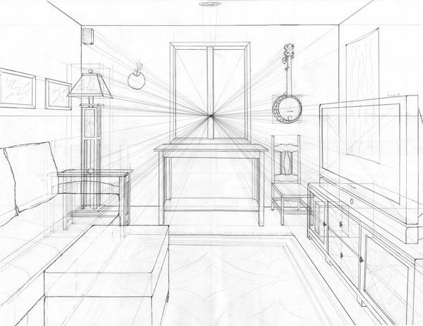
One-point perspective
These use only one vanishing point and the front view is drawn to its true size. Once the front view is drawn, all corners/points are connected to the vanishing point, then lengths are foreshortened and heights are drawn vertically.

Slide 15
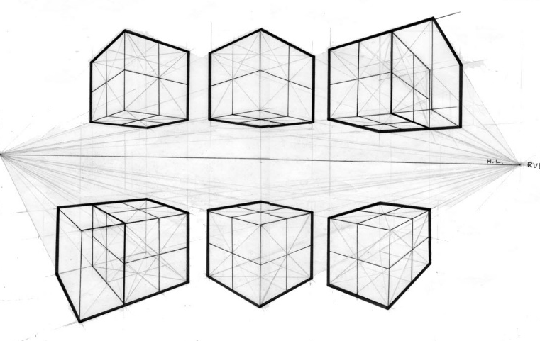
two-point perspective
This gives a more realistic perspective view, with one corner of an object drawn first and both sides disappear into each vanishing point.

Slide 16
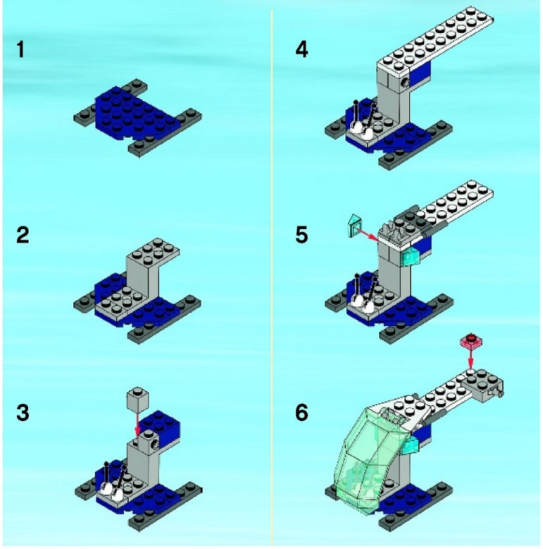
Exploded view drawings
An exploded view can be very useful when a product has multiple components and required assembly by the consumer. This is known as an assembly of parts.
For example, Lego kits come with detailed instructions with exploded views such as the one below. This enables the user of the product to clearly see where each brick should be placed at that particular stage.

Slide 17
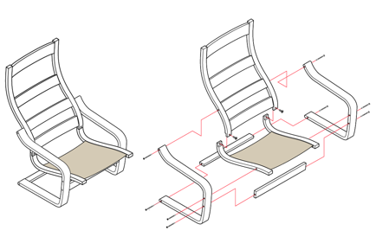
Exploded view drawings
A typical exploded view shows each component separated from each other, however it is connected along a connecting axis or plane. The general Rules of Exploded Views:
Each part should be exploded along an axis or plane that connects them when they are fully assembled.
There should be clear space between each part.
Exploded views can be easily created using CAD. Once all the parts are modelled, they can be fully assembled and then exploded to create the desired view.
Task 6
Choose a product that is assembled from multiple parts. Explore how each part connects to each other and draw a 3D exploded view. This should show using connecting axis, where each part goes together.

Slide 18
3d models
During the design process it is often useful to create a physical model or prototype of a product design using materials such as card, modelling foam or clay.
These models can then be photographed and incorporated into a design folio with annotation to explain key features of a product such as materials, moving parts, ergonomics and so on.
The different types of models are-
Sketch models (See previous slides)
Block models
Prototypes
Scale models

Slide 19
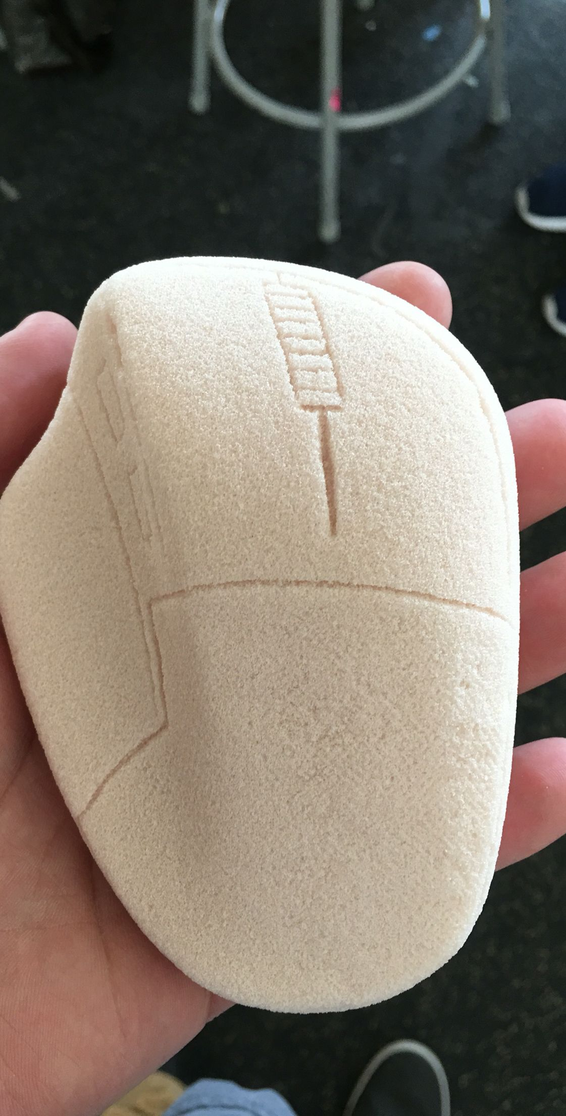
block models
This is an inexpensive method of testing a product in the real world.
Whilst the electronic and mechanical parts of the product above are not produced in modelling foam, it can be useful to test the ergonomics/form of the design and testing it with various different people to gather research and inform any design changes that are required.

Slide 20
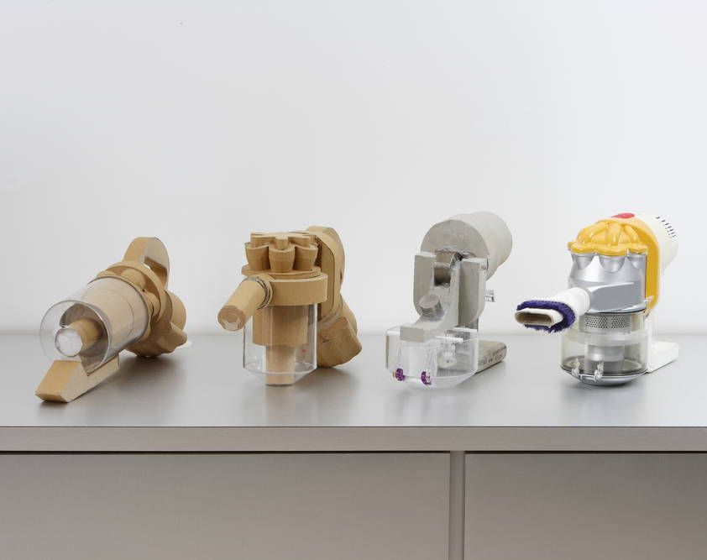
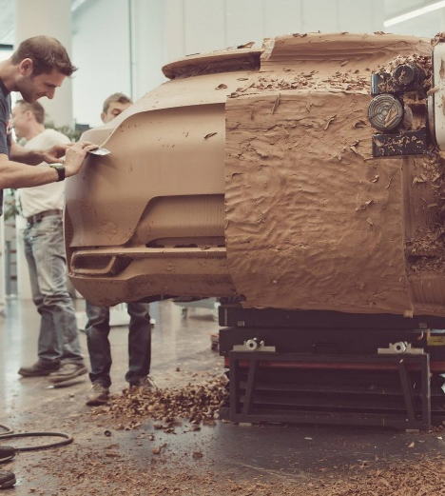
block models cont.
Cars are often prototyped in clay to test their aesthetics and ergonomics. It is easily moulded, added to and changed, which is much cheaper than creating moulded, metallic test models in the early stages.
Task 7
As part of your design folio, attempt to make some prototypes using either paper, card or modelling foam to test it. Take photos of the model/models and print these with annotation in your folio.

Slide 21
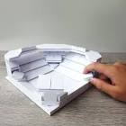
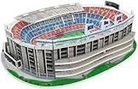
Scaled Models
Scaled models allow you to gather information on the appropriate sizes, check the overall proportion of a product, test Ergonomics of a product and check assembly methods

Slide 22
prototypes
Prototypes are different from models in that they are exact replicas of the finished commercially available product.
Prototypes are useful in the following ways-
To test the function of a product
To experience the manufacture at all stages
Difficulties in making Jigs and templates can be overcome at an early stage
To check any final stages before production
Parts can be assembled as intended
Cheap way of avoiding mistakes

Slide 23
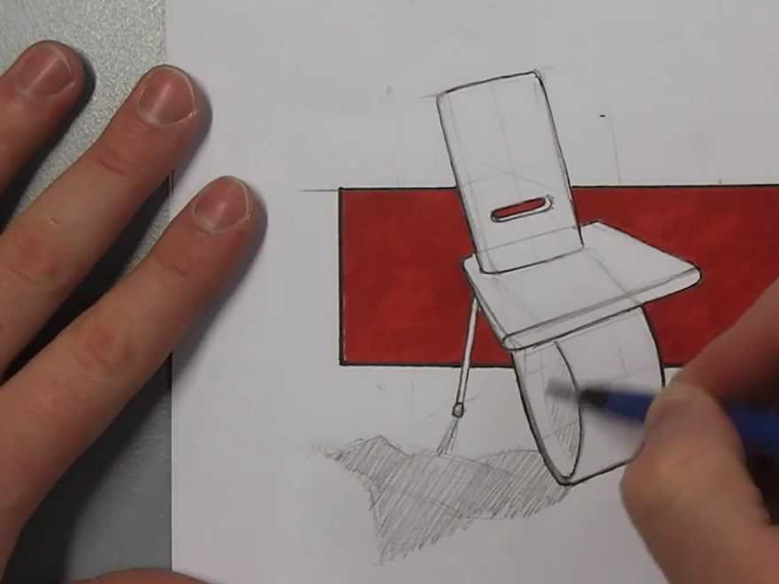
3d rendered graphics
It is useful to show the material that an object or product is made from. By using rendering techniques either by hand or using software, a more realistic image of a product can be produced to communicate effectively.

Slide 24
3d rendered graphics
Rendering by Hand
The most common methods of rendering by hand are pencil rendering and marker rendering. Each can be used to show a realistic representation of an object’s material and texture.
Rendered graphics can show highlights, shadow, colour and texture. They are often more time consuming than quick sketches, therefore should be reserved for final idea drawings.

Slide 25
3d rendered graphics
Rendering Using CAD
Using CAD (Computer-aided design) can save time and produce hyper-realistic rendered images of a product.
The product must first be modelled in 3D modelling software such as Autodesk Inventor. Once fully dimensioned, assembled (if required) and a material is applied to each surface, the CAD software can be used to set up a scenario and include lighting from any angle. The computer then renders this image to produce a realistic graphic, which can be used to communicate the ideas behind the product or for promotional purposes such as advertising.
Modelling is the most time consuming part of this process, and it eliminates any need to build physical prototypes as these can also be tested using the software.

Slide 26
Exam questions
When asked about graphics in the design process in an exam question, you should consider discussing the following:
Suitable responses: Variety of graphics available (2D/3D sketch, orthographic, oblique, one-point perspective, isometric, two-point perspective, exploded/assembly, sectional, scale drawing, working drawing, rendered - all can be manual or CAD.)
Idea generation
Graphics used at this stage are mainly exploratory. Simple, quick sketches outlining the basic idea. No need for too much detail or rendering.
freehand and carried out at a fast pace
range of 2D/3D sketches
oblique
isometric
perspective.

Slide 27
Exam questions
Development — exploration/refinement
Graphics used at this stage are initially exploratory and will become progressively more detailed.
designer will still be problem solving, graphics may still be produced quickly
some explanatory graphics may begin to appear to help visualise emerging details
range of 2D/3D sketches
pictorial drawings
scale drawings
orthographic/dimensioned drawings of emerging details
exploded sketches of emerging details
sectional sketches of emerging details rendered views. (manual/CAD)

Slide 28
Exam questions
Production
Graphics used at this stage are to aid production. These will be rich in information containing sufficient detail to allow prototypes to be made and final manufacture to take place. These graphics require a high degree of accuracy.
dimensioned orthographic drawings/working drawings — produced on CAD or with drawing equipment
sectioned orthographic
exploded.
Presentation
Graphics used at this stage are mainly presentation/promotional. These graphics would be used to communicate the design to the client and for advertising purposes. These must not be too technical as the client may not understand them.
must provide a very clear image that is visually appealing
graphics should look as realistic as possible
manual rendered illustration
render CAD illustration/animations.

